Slide 1


DoBlood Mobile Application
Devang Patel Institute of Advance Technology and Research

Slide 2
Our Team
Deep Prajapati
18DCE099
Pratyush Rajpara
18DCE100
Kashyap Shah
18DCE115
Meet Shah
18DCE117

Slide 3
Outline
Abstract
Features
Timeline
Current System and its limitations
Proposed system
Snapshots
Future Scope
Conclusion

Slide 4
“DoBlood” is a mobile-based project developed in android platform. This android project provides an easy and fast way to search for blood.
This app enables users to find blood in emergency situations.
Here Users can easily find the details of donors and receivers through their mobiles.
Users need to register with the application to view all the information which is available on the app.
The user can search the details and find the details of the blood donors. Users can get brief details about the donor’s contact details including their location. The user can make a call or message directly by using this application.
Abstract

Slide 5
Features
100% FREE
We never take money and we never make money for blood.
Donor List
Get donor list of your blood group.
Find Blood Donor from MAP
Calling hundred of Blood donor is no more required using our platform.
Donation Camp
Can organize Blood Donation Camp and post details in app
Interface
Easily understable and simple interface of application.

Slide 6
Timeline
Reviewing the problem
Backend development
02-2020
04-2020
01-2020
03-2020
05-2020
Reviewing the problem
Frontend Development
UI Development

Slide 7
Current System and its limitations
The existing blood donations system includes a lot of manual work which takes a lot of time and physical effort. Users need to connect to the internet if they want to know the details of the blood donors.
It takes a lot of time and effort to collect information about blood donors or receivers. Proper information is not available to the users.
A person who need blood then he have to contact to hospitals or blood donation camps ext.

Slide 8
Proposed System
In the proposed blood banking system, the information about donors can be found in an easy and simple way which does not take any time or effort.
This system provides an easy way to search donors and request for blood within less time .
Users can search details of the donors and can get their contact details including the location. This system enables users to communicate with donors directly which avoids miscommunication.

Slide 9
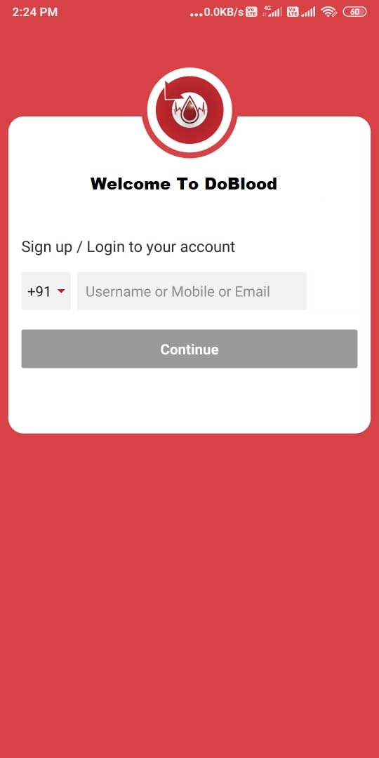
Snapshots
Login page
Login and SignUp page using email or mobile number

Slide 10
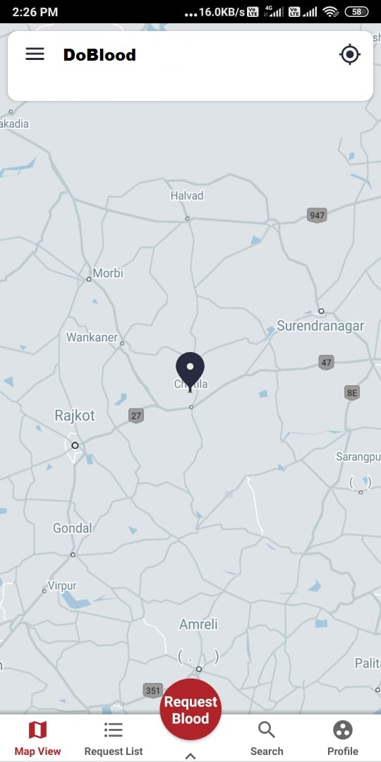
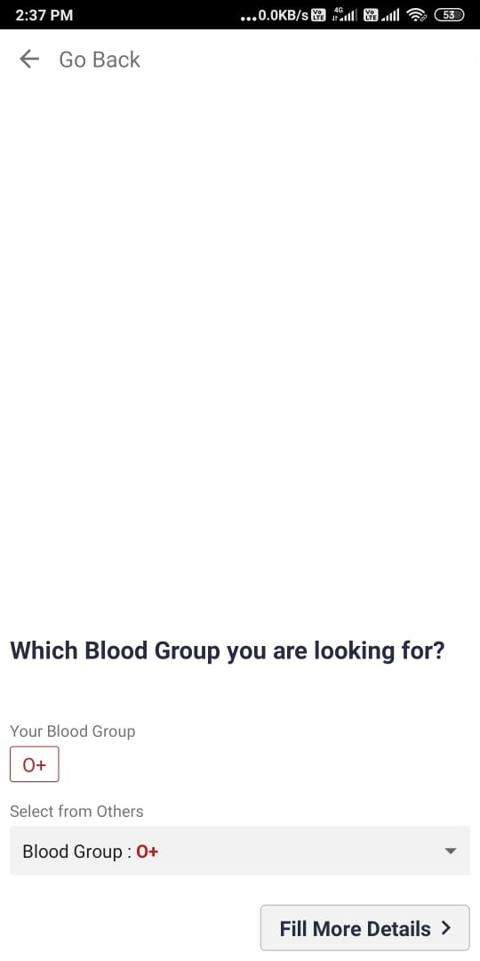
Snapshots
Request Page 1
When user press on Request Blood, this page opens.
This page ask for which blood you need.

Slide 11
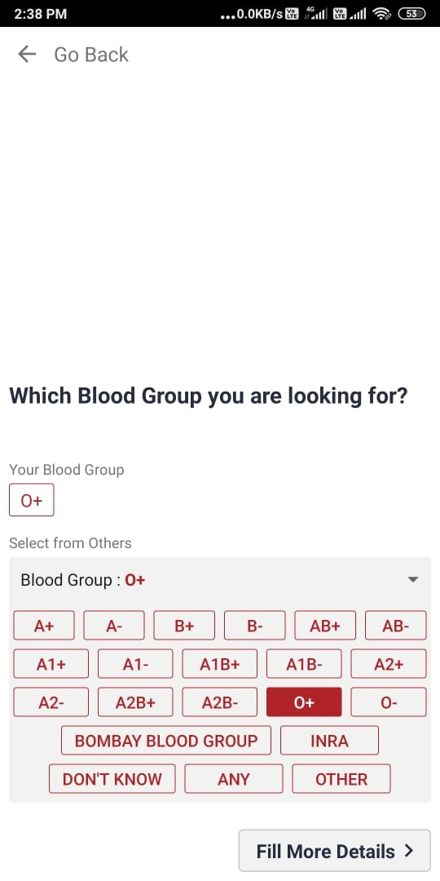
Snapshots
Request Page 1.1
This page shows that when user need blood that is different from his\her own blood group.

Slide 12
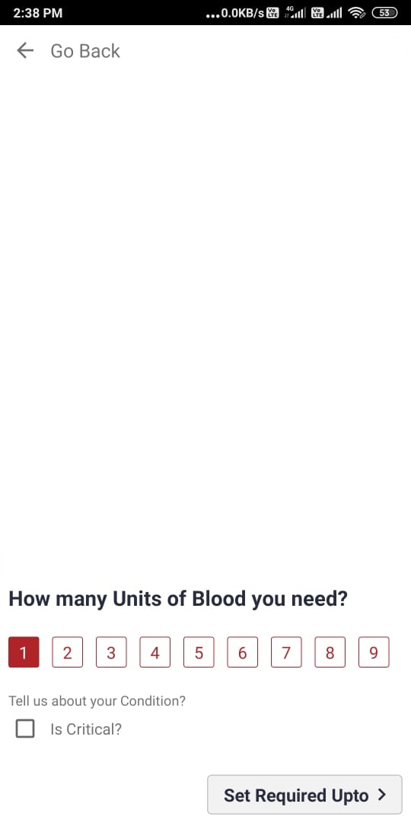
Snapshots
Request Page 2
In this page user have to select that how many units of blood are needed.

Slide 13
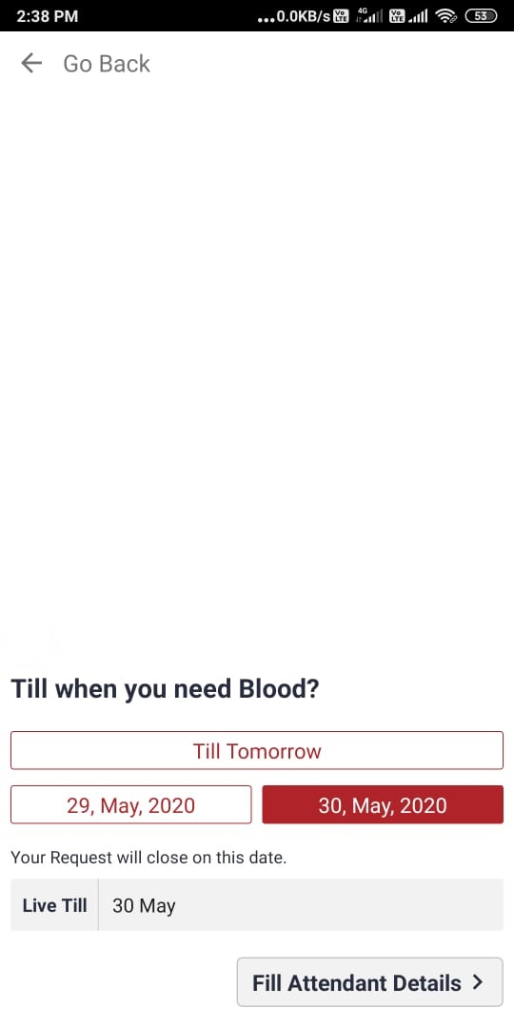
Snapshots
Request Page 3
In this page user have to select deadline in which they need blood.
After deadline crossed the request went away

Slide 14
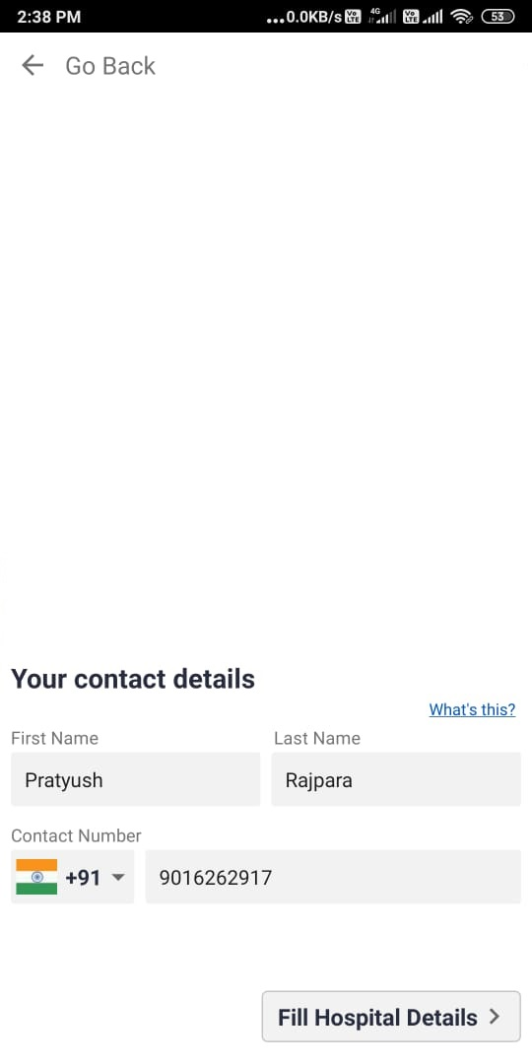
Snapshots
Request Page 4
In this page user have to give phone number.
The donor who accept your request then he/she can contact you.

Slide 15
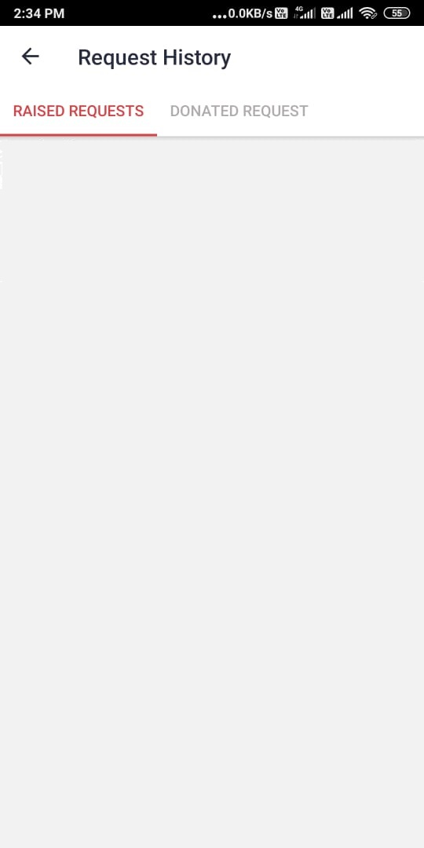
Snapshots
Request history
In this page app shows that which request you raised and requests which you fulfilled for requested users.

Slide 16
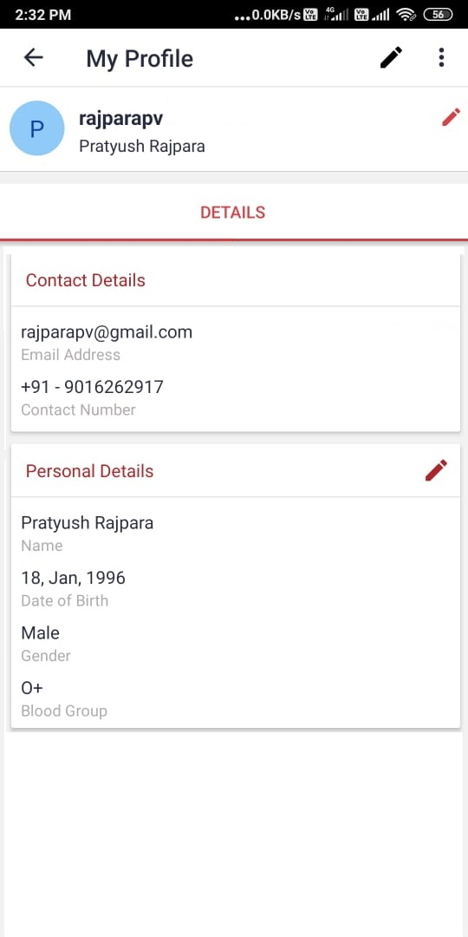
Snapshots
Profile Page
This page allows you to see your profile and also provide interface for edit your profile details.

Slide 17
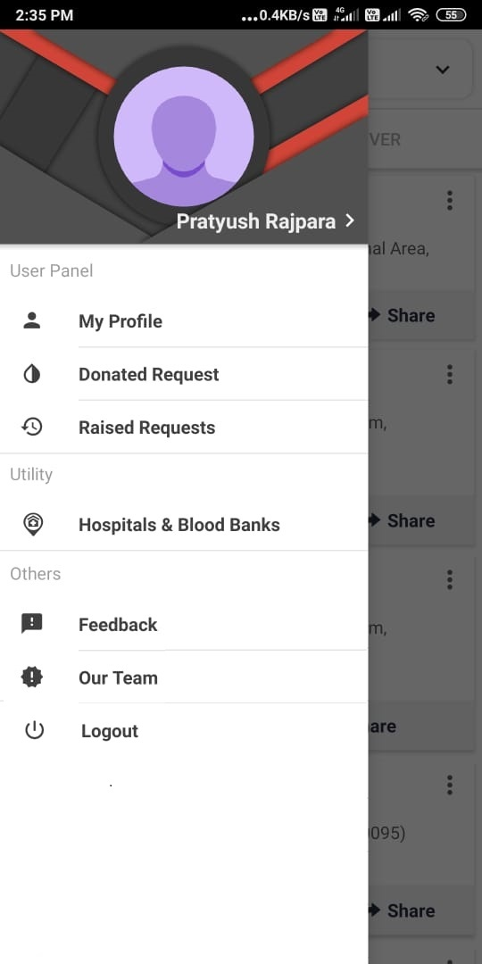
Snapshots
Side Menu
Quick link to move on certain pages.

Slide 18
Snapshots
Opens Profile Page
Opens List of request which you have donated.
Opens list of requests that you have raised.
Side Menu
Quick link to move on certain pages.
Logout Button

Slide 19
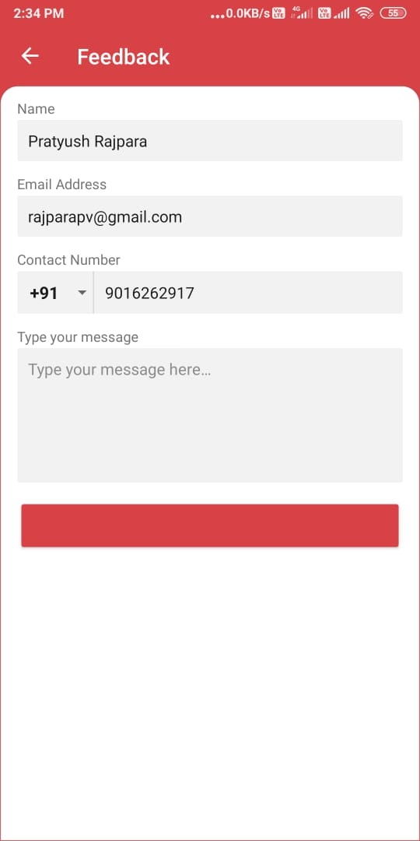
Snapshots
Side Menu
A quick feedback page

Slide 20
Future Scope
Include Blood Bank.
Include Automation request system in our application.
Create Web Application so that it will be easier to operate for hospital’s blood bank management staff.
Implement map functoriality.

Slide 21
Conclusion
our Indian society needs lots of automation techniques to make India developed country.
So we are happy to takeover this project.
We also learn android studio, team work and also improve over problem solving technique.

Slide 22
Refrences
https://developers.google.com/maps/documentation/android-sdk/start
https://developer.android.com/guide/topics/ui
https://stackoverflow.com/

Slide 23
THANK YOU

